Slide 1


Meal Mind
Today's Recipe
Taha Hasnian Raza BSCE20027 Saud Sohail BSCE21022

Slide 2
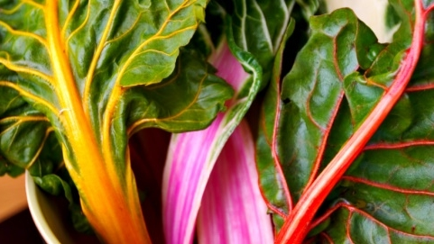

Problem
What to make Today?
How to make it?
What are the other options?

Slide 3
Solutions
Provides recipe(s) on the basis of ingredients available
Provides Dish recommendation for a family and a single person
Easy cooking recipes

Slide 4

Harvesting seasons

Slide 5
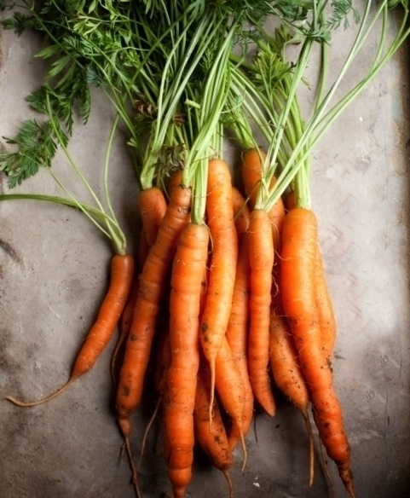
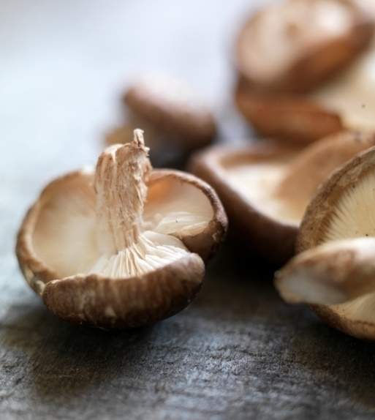

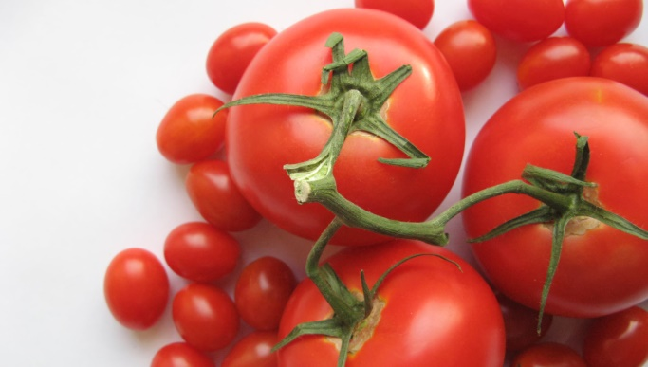
Our process
Plant
Grow
Pick

Slide 6
Thank you
someone@example.com

